Slide 1
Time Series Analysis
Extract rotation period and/or orbital period from time series data of asteroids

Slide 2


Slide 3
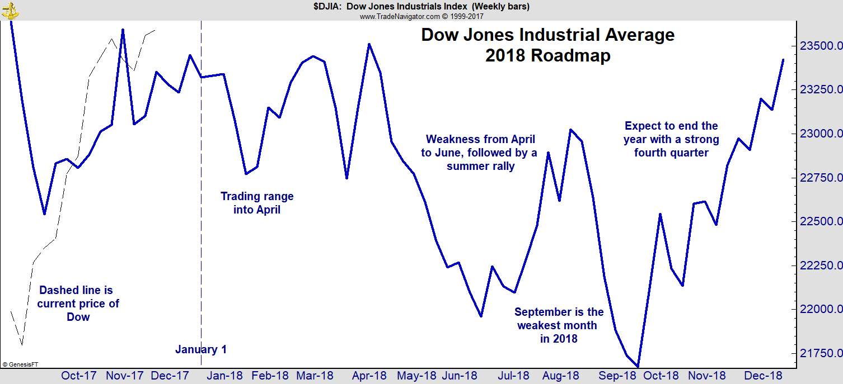
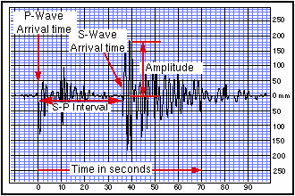
Samples of Time Series Data
Stock Market
Seismic Signal from Earthquake

Slide 4
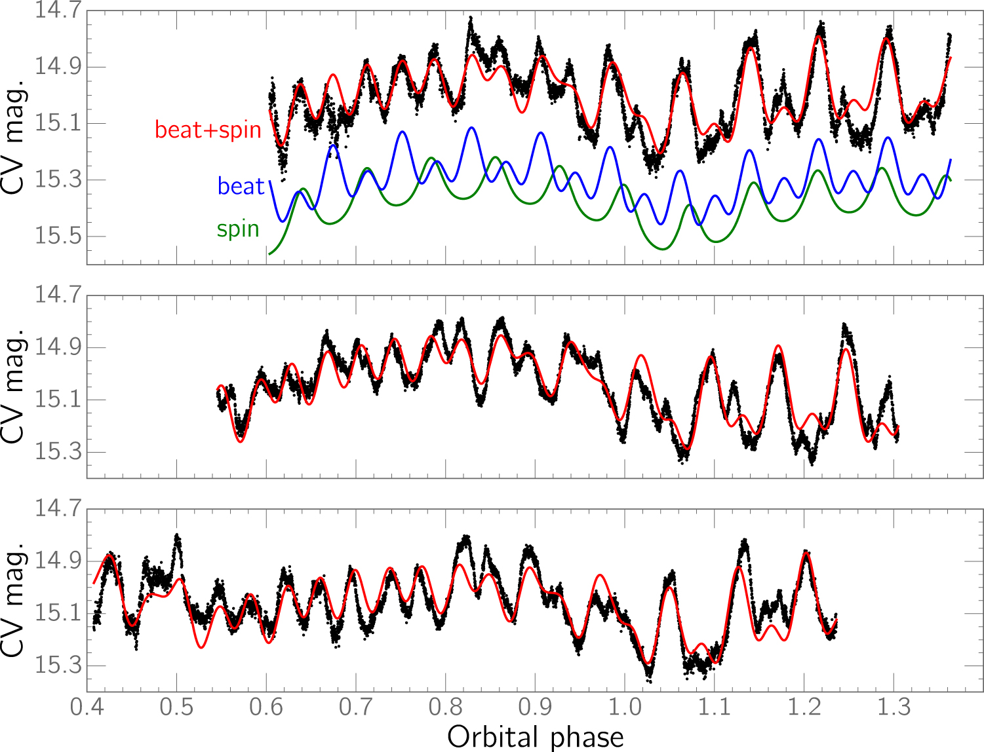
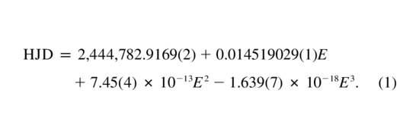
FO Aquari: “King” of the IPs

Slide 5
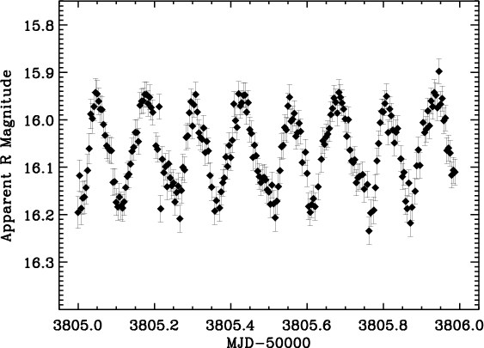
One Day of Data

Slide 6
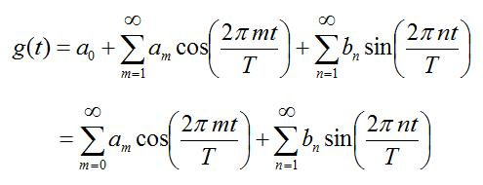
Fourier Analysis
The above is a Fourier series representation of the periodic function g(t), period = T

Slide 7
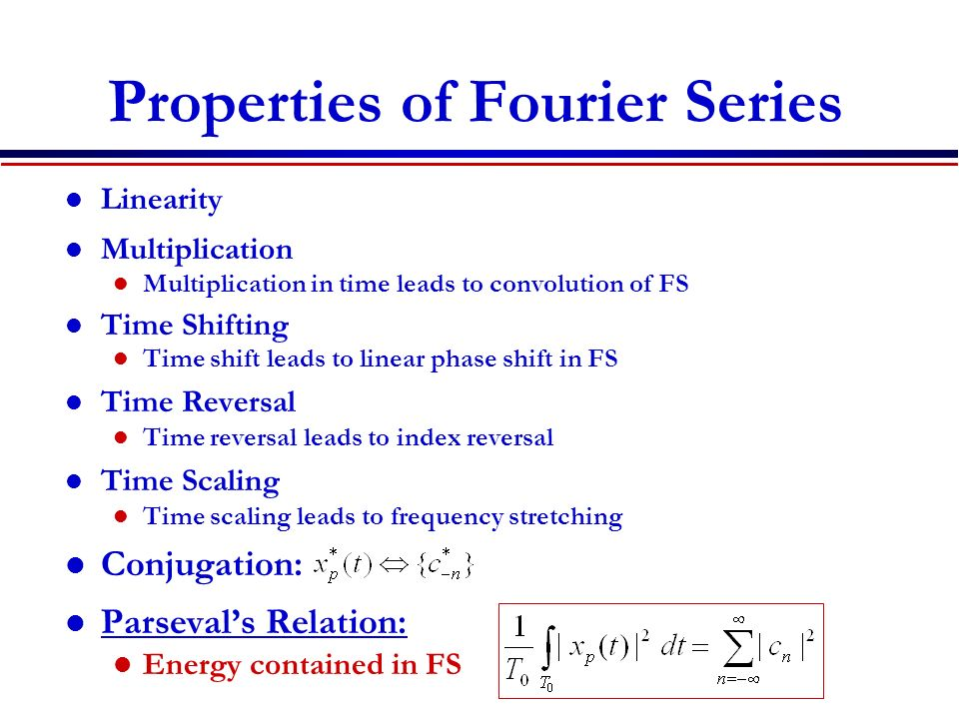

Slide 8
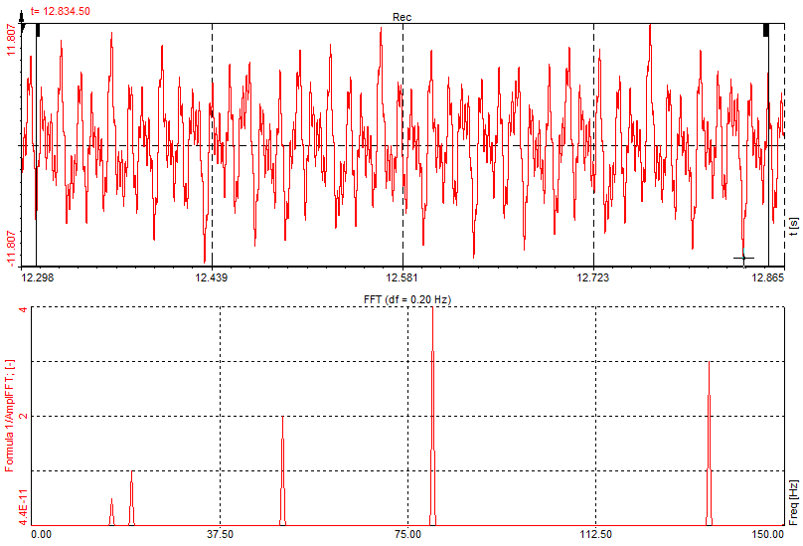
Fitting a Fourier series to long strings of unevenly spaced data is straightforward, but inefficient from a computational standpoint. The work scales as N² where N is the number of data points
When the data points are evenly spaced, the numerical problem has a clever solution, the so-called the FAST FOURIER TRANSFORM (FFT) which, IMO, is the computer algorithm of the last 100 years. The FFT scales as N log_{e} N << N² for large N.
Application of the FFT to the data below allows a rapid decomposition of the time series showing that a seemingly random process is actually a linear combination of a small number of waves

Slide 9
For a time series g(t) represented by
the goal is to determine the coefficients a_{m} and b_{n} to show how different waves mix to form the signal. This is accomplished by utilizing the property sine and cosine functions are orthogonal over the range [0,T].

Slide 10
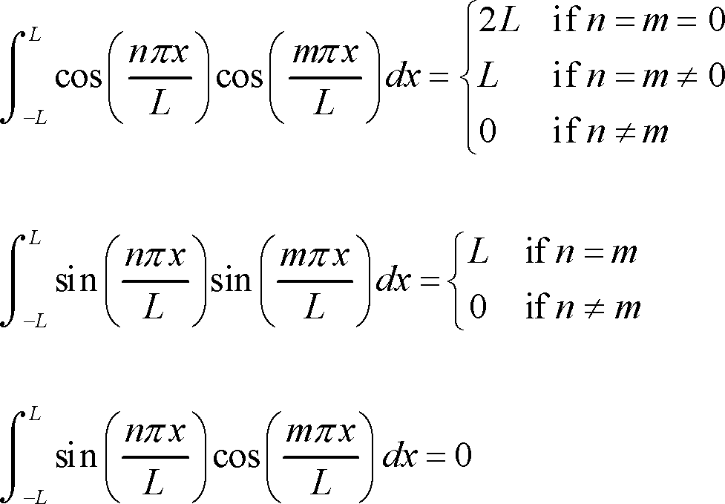
Note: Let L = T and x = t to recover our formulation.

Slide 12
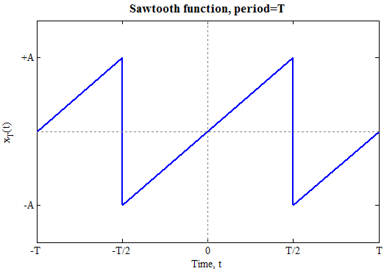

Example: Sawtooth

Slide 13
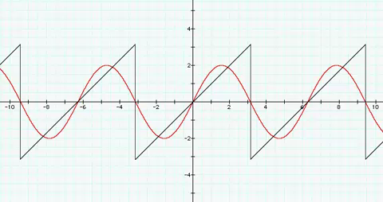
Fourier Series:: x(t) = Σ(-1)^{n+1}(2A/πn)sin(2πnt/T)

Slide 14
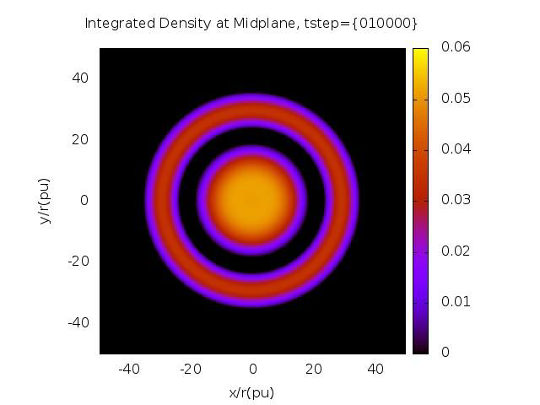
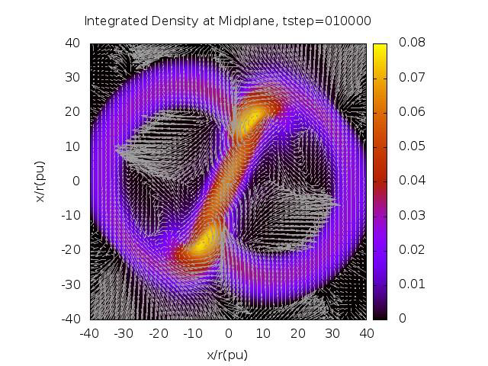
Example: Numerical Simulation
Numerical Simulation of young stellar object surrounded by a massive protoplanetary disk. Top down view of density structure in the equatorial plane of the system.

Slide 15
Example: Numerical Simulation

Slide 16
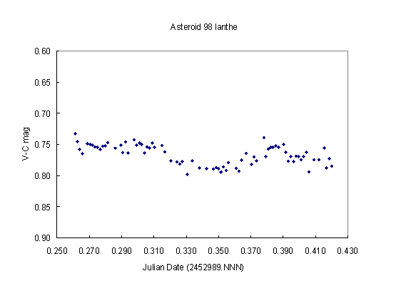
More Typical Single Observation

Slide 17
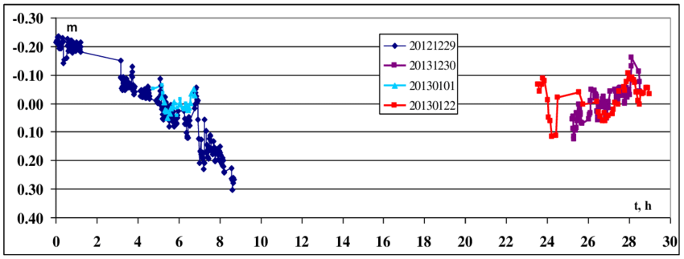
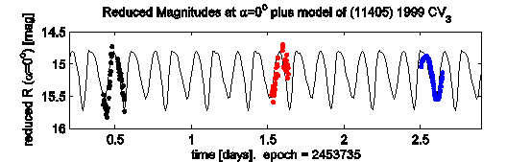
Several Nights of Data

Slide 18
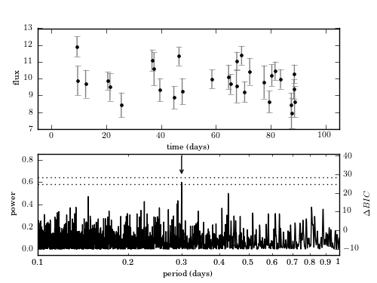
Unevenly Spaced and Sparse Data: Use Lomb-Scargle Periodogram

Slide 19
Complications
Viewing Aspect
Time System
Orbit-to-Orbit variation
Rotation-to-Rotation variation
…

Slide 20
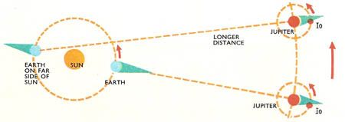
Time Systems?
Which system to use?
Actually a tricky problem because when stringing data taken on different days to form one time series, how far away is the asteroid from the Earth affects the light travel time between the asteroid and us, and so affects how long it takes a pulse of light to reach us.

Slide 21
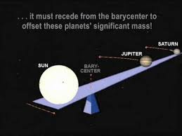
Not a problem over the course of a night, errors of only up to ~0.05 s or so may arise.
It could be a problem if one wants to string data from several nights separated by weeks together. To overcome this, we convert all times to some standard frame, the barycentric dynamical time TDB, times as if measured at the barycenter of the Solar System.
Barycenter corresponds to the balance point

Slide 22
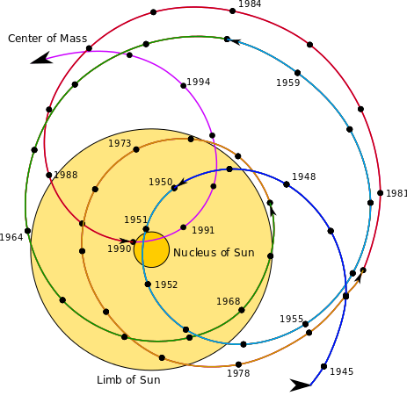
Motion of the barycenter of the Solar System with respect to the Sun*
*Barycenter actually moves steadily, the Sun moves about the barycenter.

Slide 23
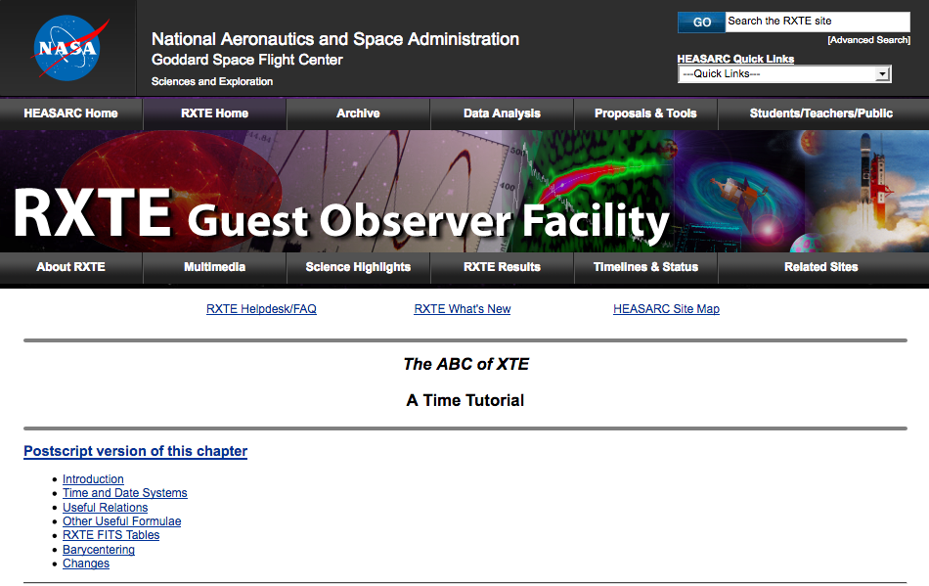
https://heasarc.gsfc.nasa.gov/docs/xte/abc/time_tutorial.html

Slide 24
TAI (International Atomic Time): Based on the SI second and derived from a large number of clocks all over the world. Analyzed and published by by BIPM. Reduced to mean sea level.
UTC (Universal Time, Coordinated): Based on the SI second, it knows days of 86400 and 86401 seconds. The latter are days with a so-called leap second. The objective is to keep UTC within a second of UT1, which is based on the earth's rotation. The offset from TAI is always an integer number of seconds (the accumulated leap seconds).
TT (Terrestrial Time): An idealized time, for all practical purposes based on TAI, but with a constant offset to provide continuity with Ephemeris Time. Defined on the rotating geoid.
TB (Barycentric Time): Also known as TDB (Barycentric Dynamical Time). This is basically TT transformed to the solar system barycenter.
JD (Julian Date): Number of days since Greenwich mean noon on January 1, 4713 B.C. Note that JD may be used in conjunction with all of the above time systems; whenever the required accuracy dictates this, the time system used should be indicated: e.g., JD (TT).
MJD (Modified Julian Date): Equals JD - 2400000.5. The same note applies as for JD concerning the time system in use. We shall continue to use MJD notwithstanding the IAU's recent decision not to recognize MJD anymore as an official time unit.

